Slide 1
Go the following URL to register for Amazon Web Services
https://www.amazon.com/ap/signin?openid.assoc_handle=aws&openid.return_to=https%3A%2F%2Fsignin.aws.amazon.com%2Foauth%3Fresponse_type%3Dcode%26client_id%3Darn%253Aaws%253Aiam%253A%253A015428540659%253Auser%252Fhomepage%26redirect_uri%3Dhttps%253A%252F%252Fconsole.aws.amazon.com%252Fconsole%252Fhome%253Fstate%253DhashArgs%252523%2526isauthcode%253Dtrue%26noAuthCookie%3Dtrue&openid.mode=checkid_setup&openid.ns=http%3A%2F%2Fspecs.openid.net%2Fauth%2F2.0&openid.identity=http%3A%2F%2Fspecs.openid.net%2Fauth%2F2.0%2Fidentifier_select&openid.claimed_id=http%3A%2F%2Fspecs.openid.net%2Fauth%2F2.0%2Fidentifier_select&action=&disableCorpSignUp=&clientContext=&marketPlaceId=&poolName=&authCookies=&pageId=aws.ssop&siteState=registered%2Cen_US&accountStatusPolicy=P1&sso=&openid.pape.preferred_auth_policies=MultifactorPhysical&openid.pape.max_auth_age=120&openid.ns.pape=http%3A%2F%2Fspecs.openid.net%2Fextensions%2Fpape%2F1.0&server=%2Fap%2Fsignin%3Fie%3DUTF8&accountPoolAlias=&forceMobileApp=0&language=en_US&forceMobileLayout=0

Slide 2
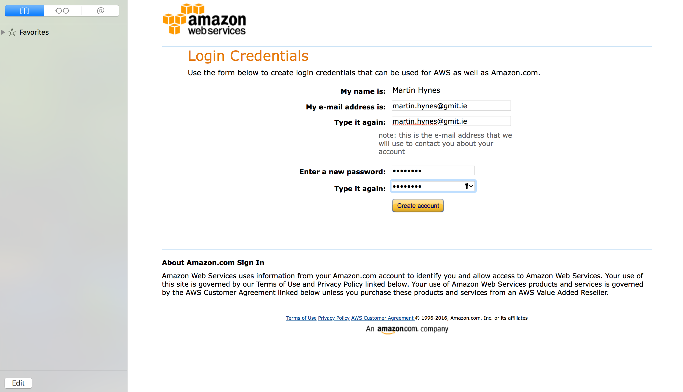

Slide 3
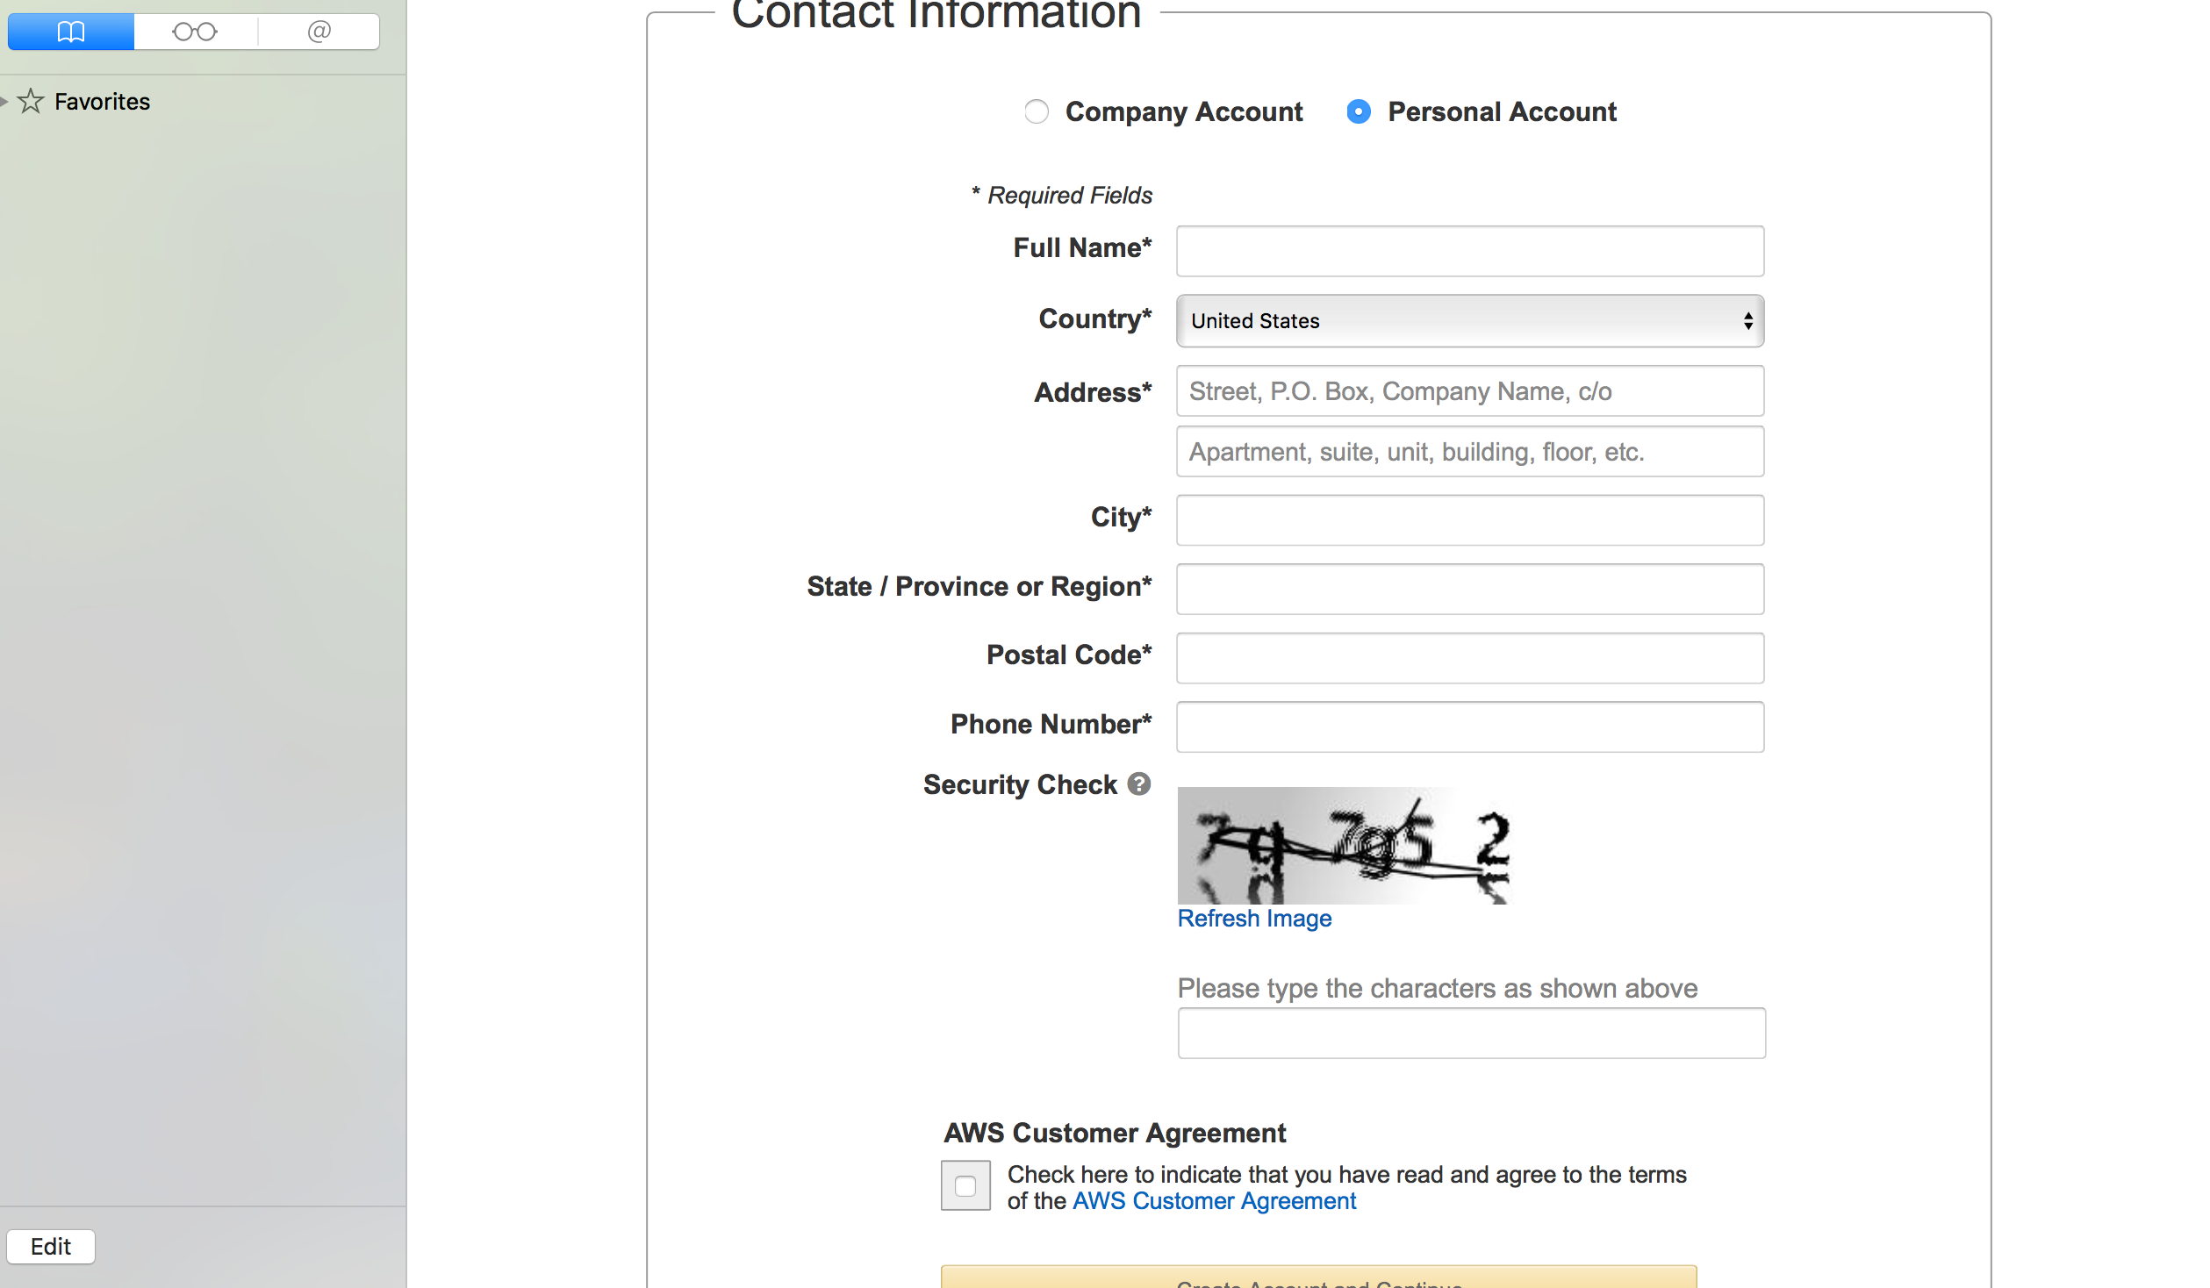

Slide 4
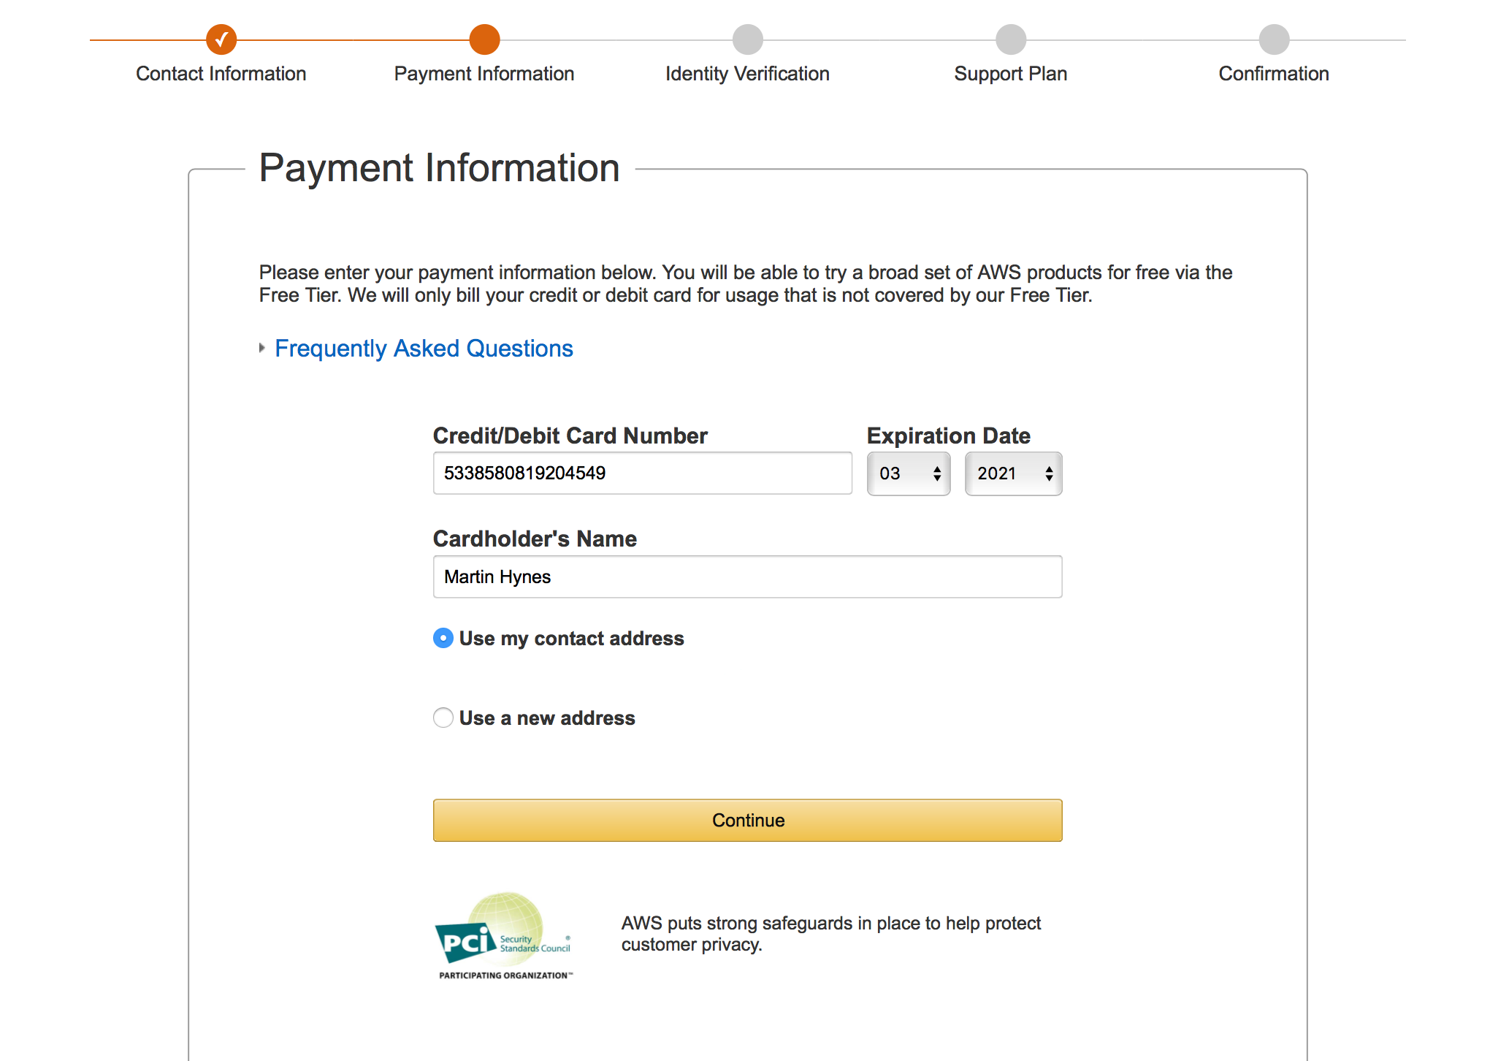

Slide 5
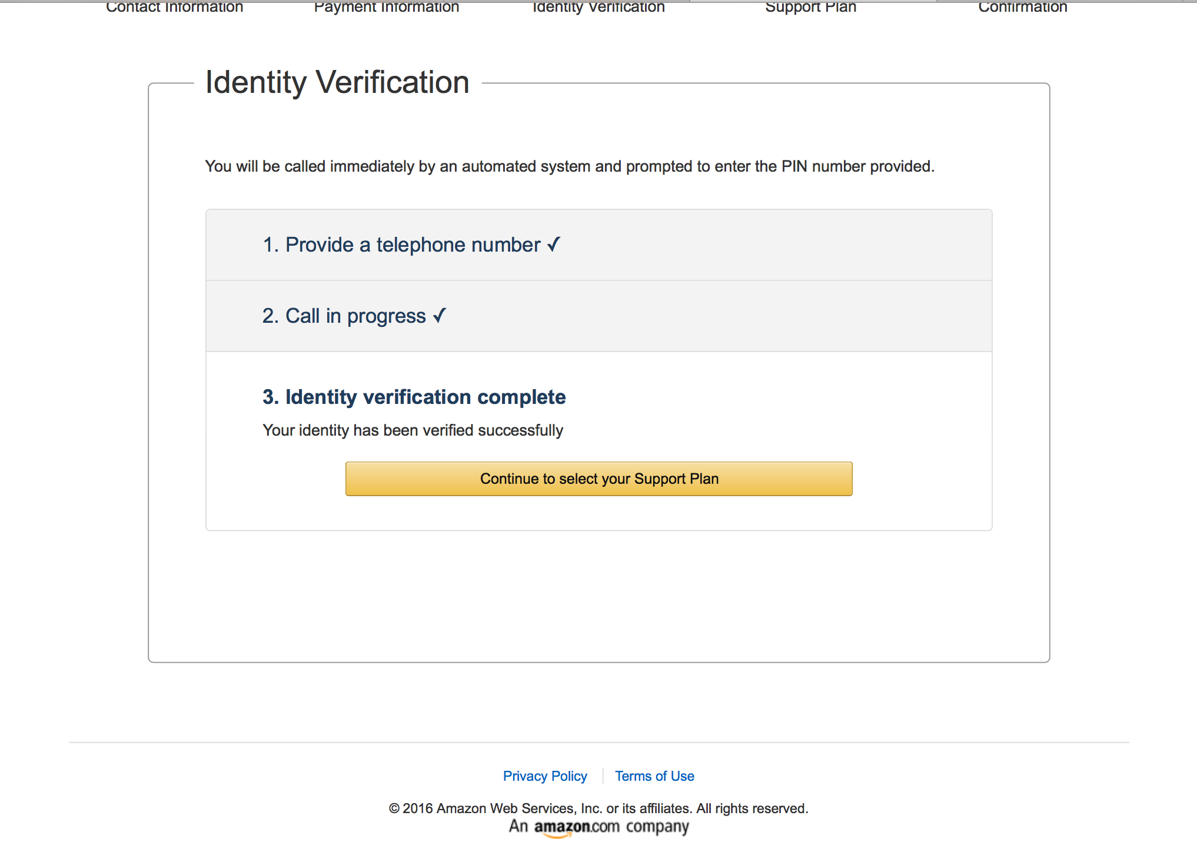

Slide 6
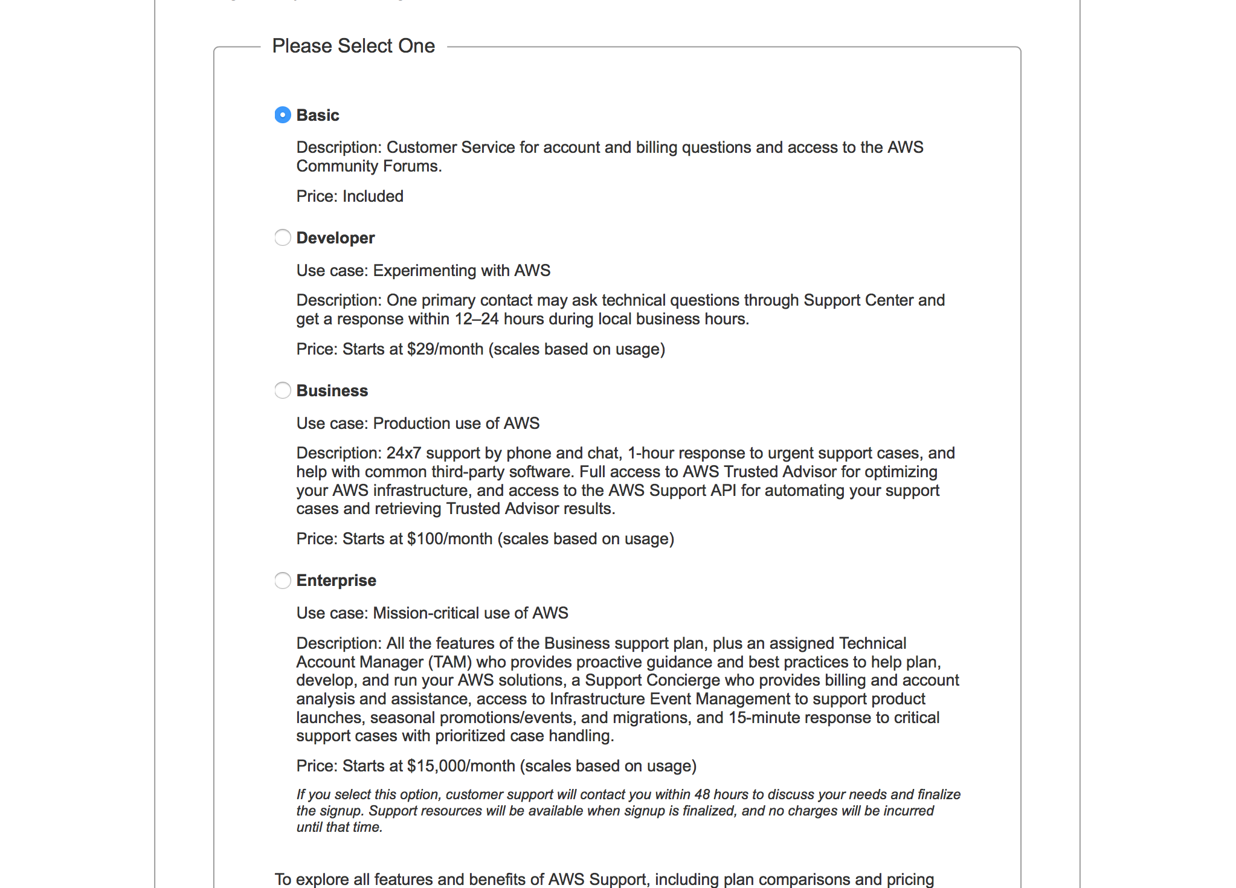

Slide 7
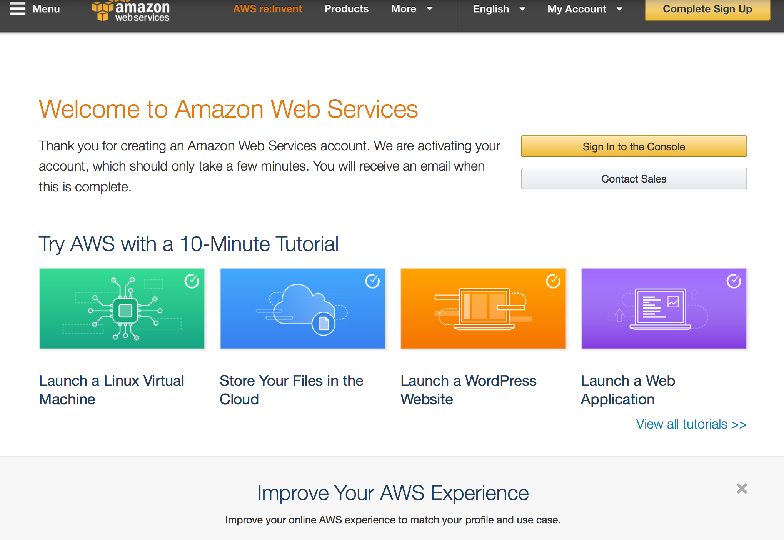

Slide 8
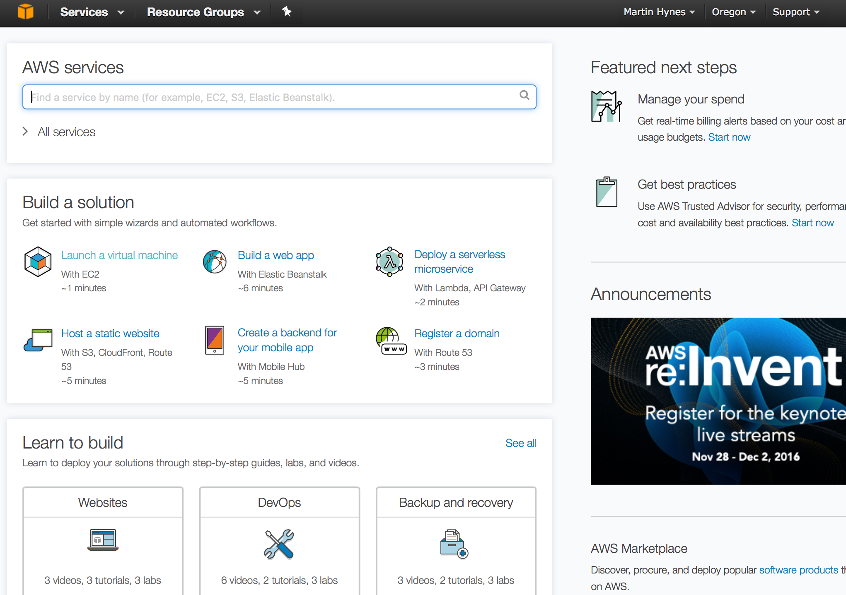

Slide 9
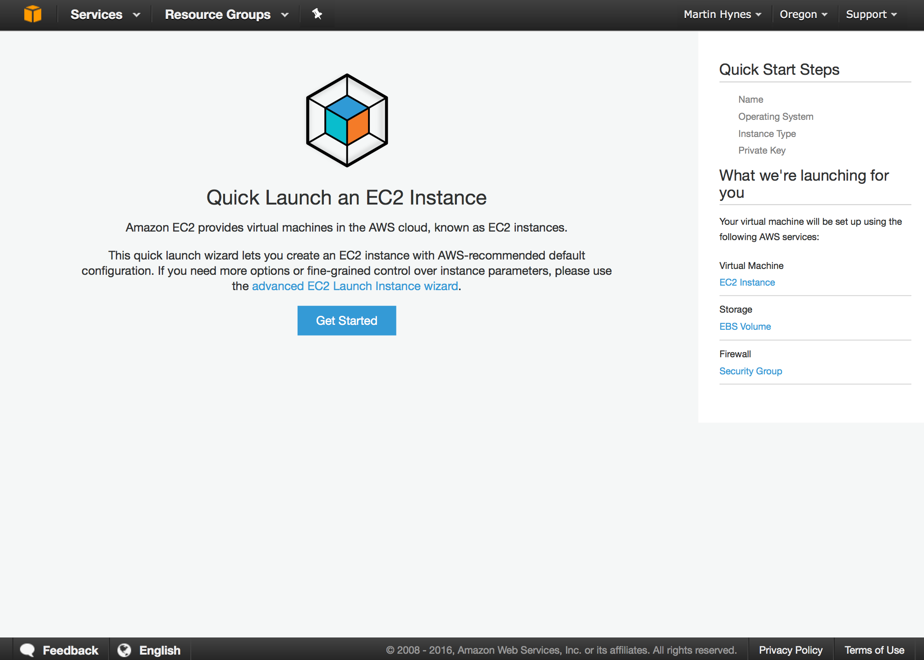

Slide 10
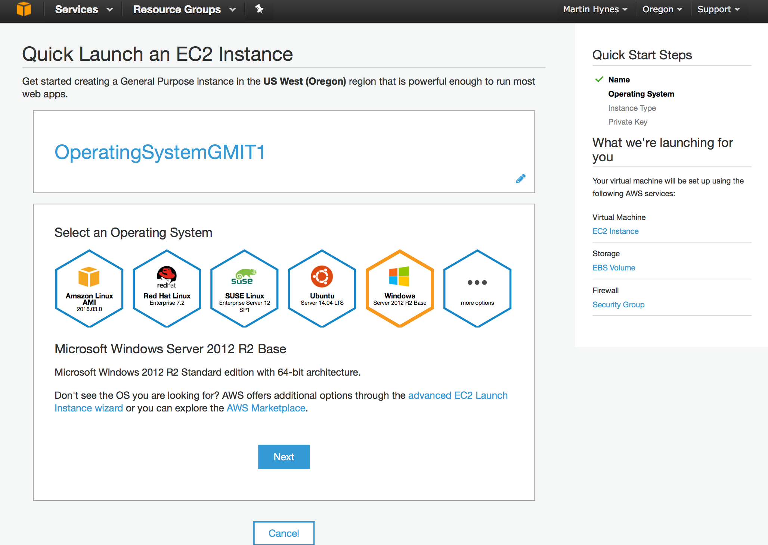

Slide 11
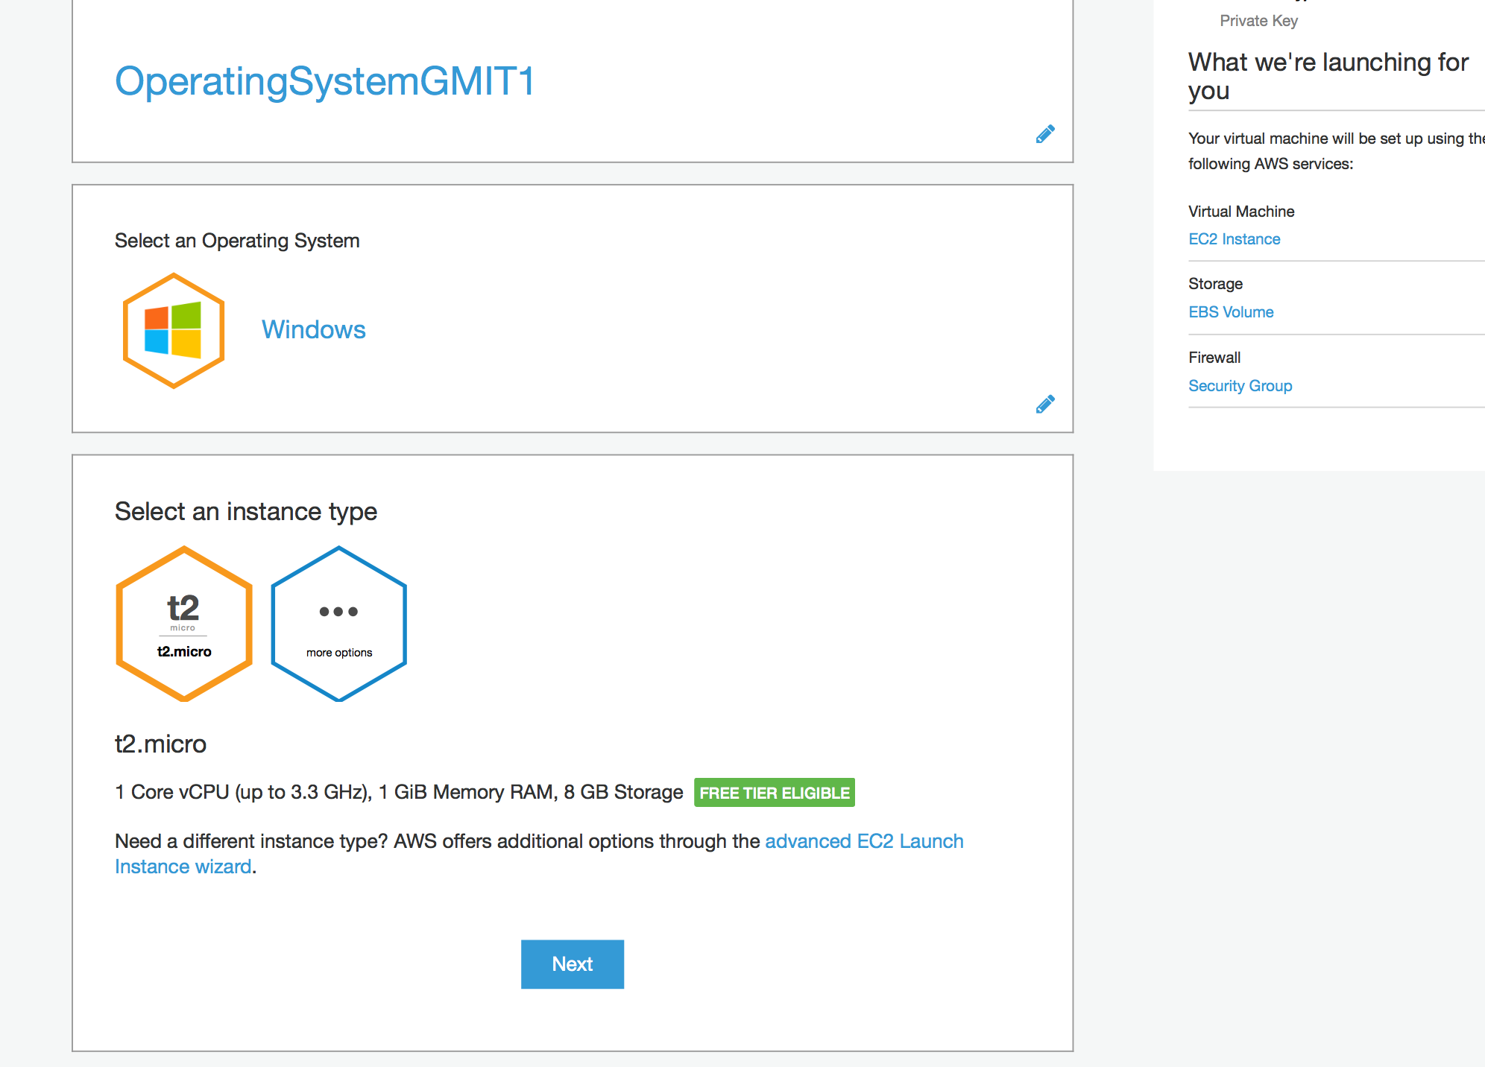

Slide 12
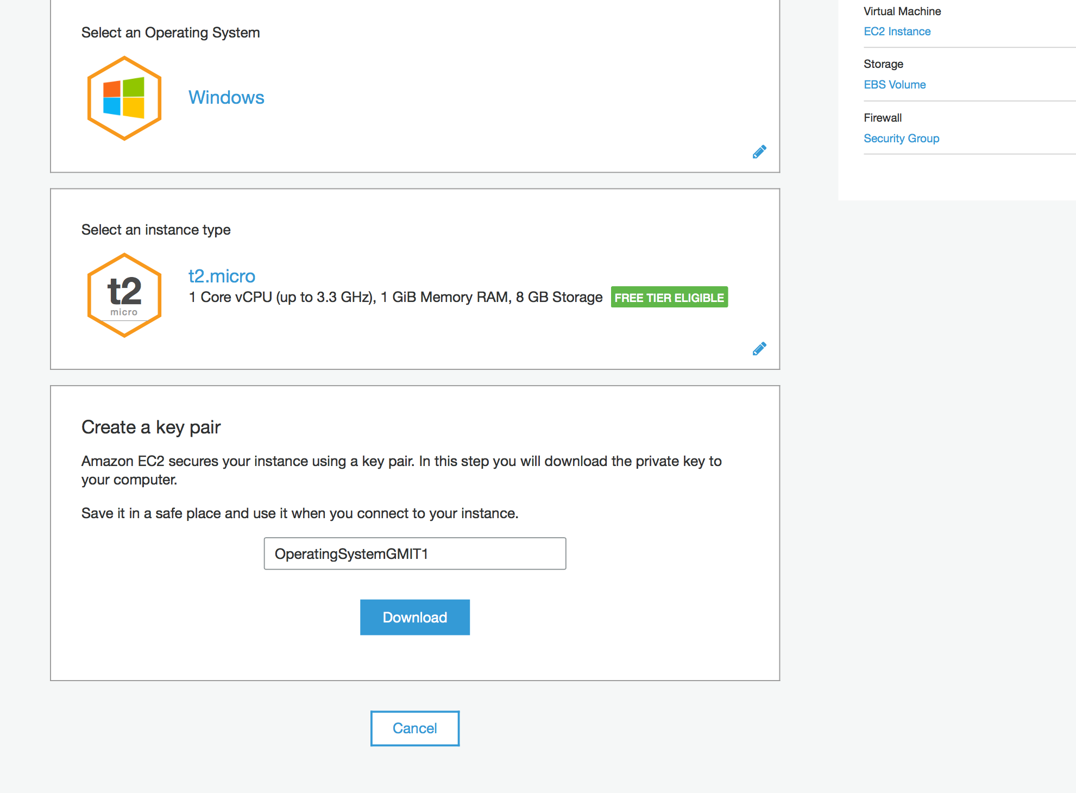

Slide 14
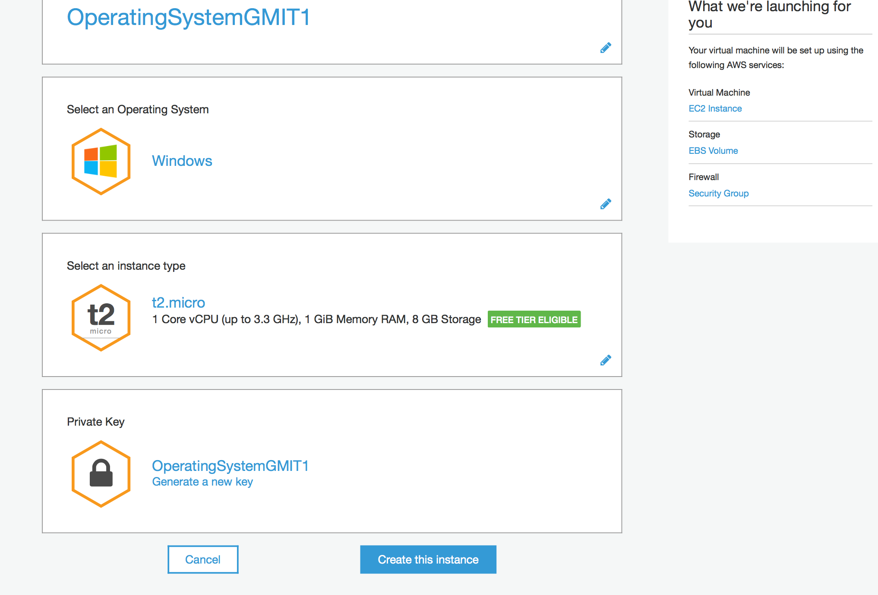

Slide 15
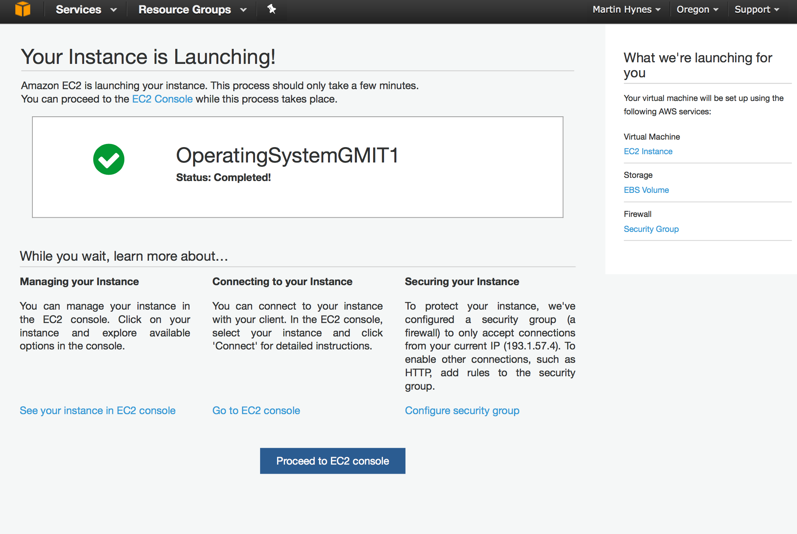

Slide 16
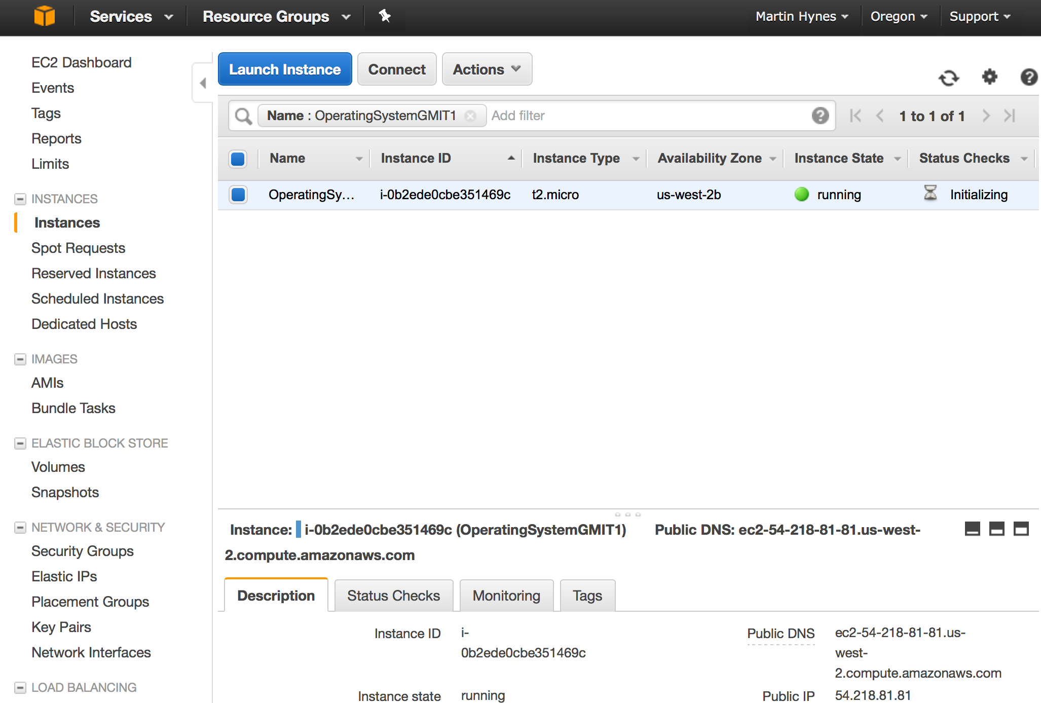

Slide 17
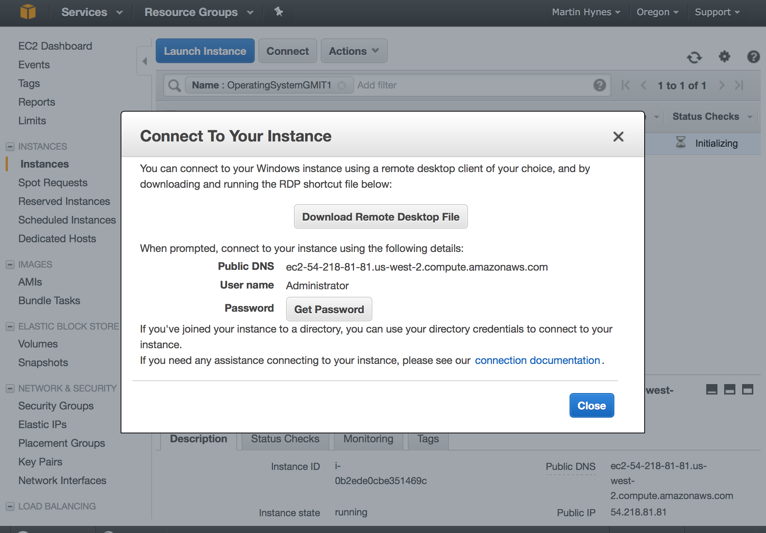

Slide 18
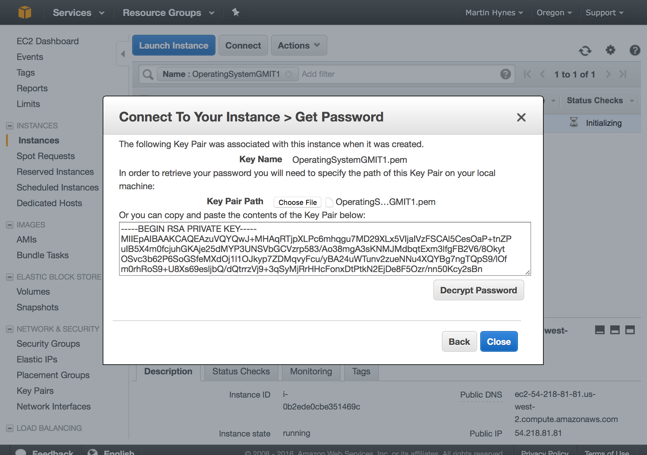

Slide 19
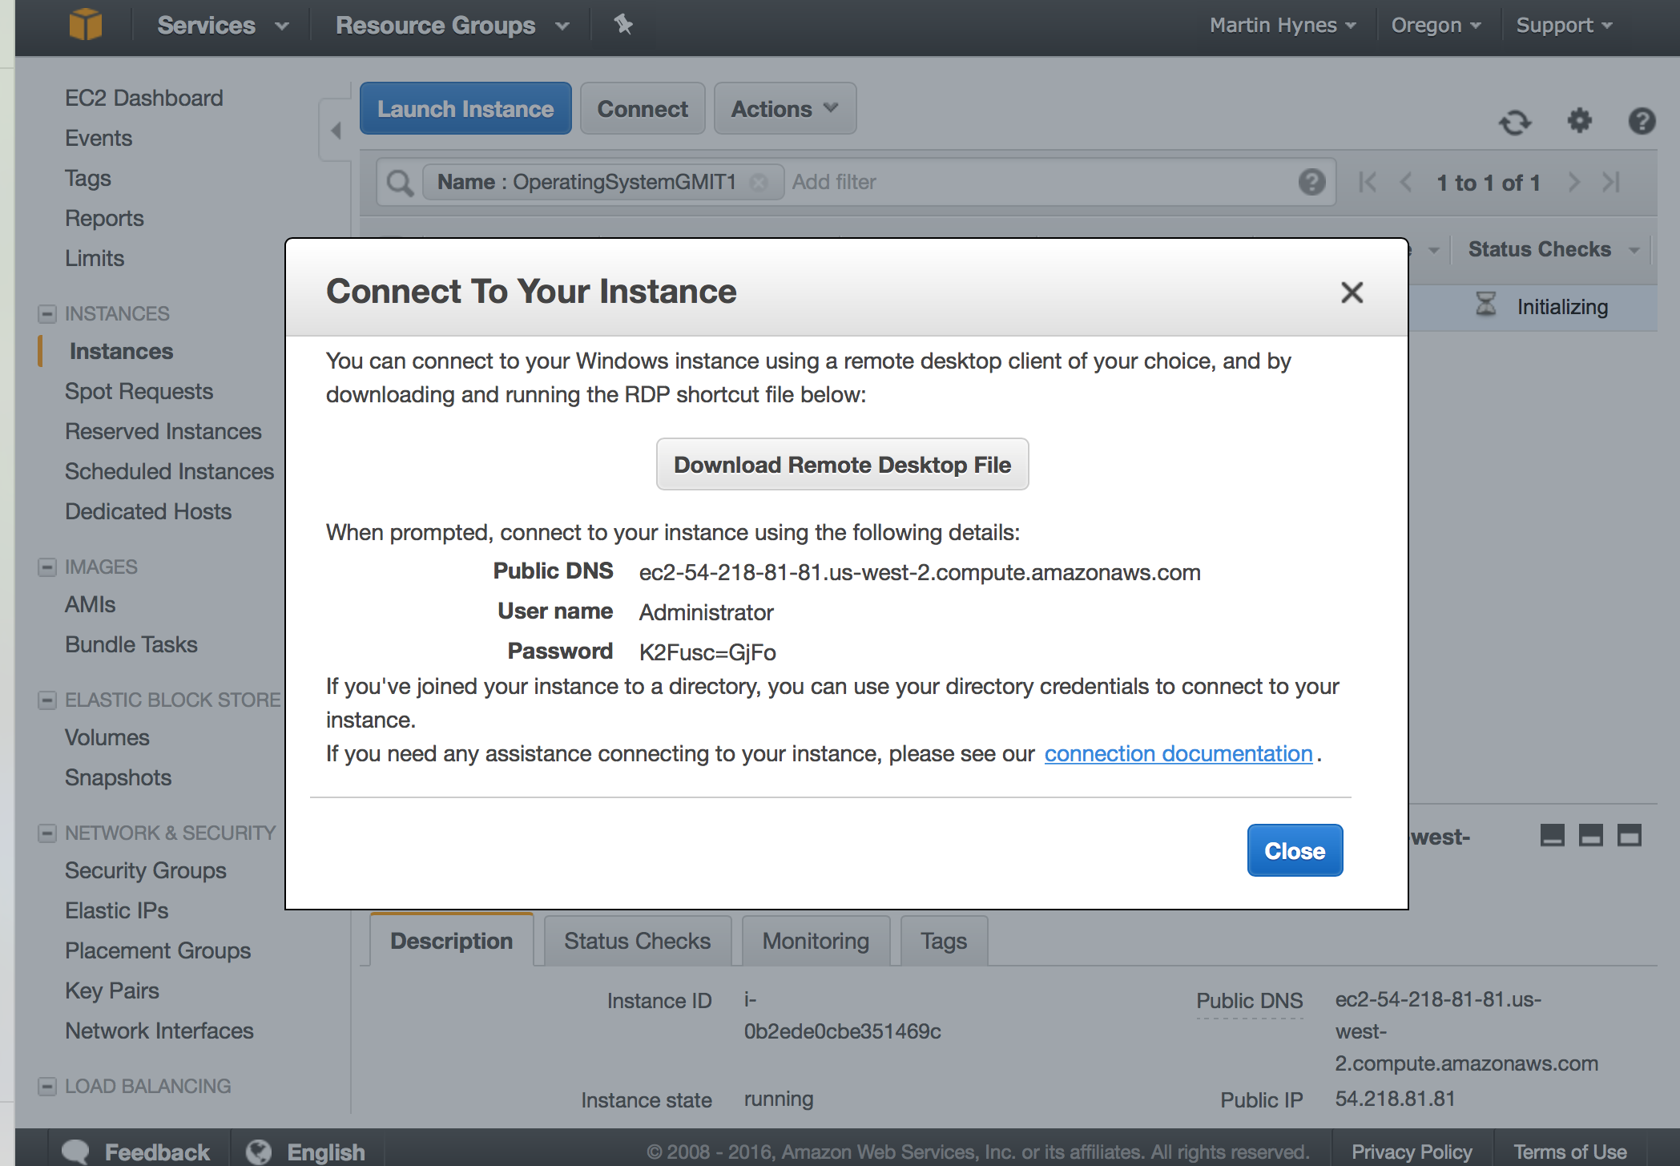

Slide 20
